Slide 1
Dynamic Stopping in P300 Speller with Variational Bayesian Neural Network
Chao-Li Wei, Simon Fei, Eugene Kim,
Quinton Ramaswamy, Joelle Faybishenko,
Andrew Wong, Bailey Man

Slide 2
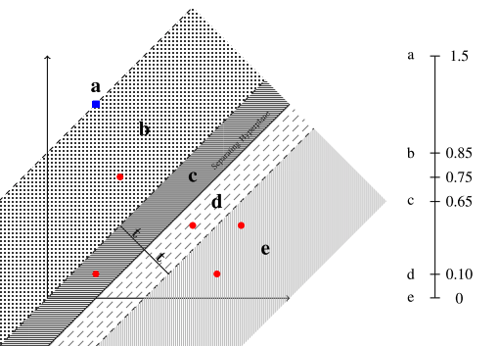
Analysis of Previous Adaptive Stopping Methods
Previous research have compared classifier outputs to a threshold for a dynamic stopping approach
Ex. Mapping the distance from the SVM hyperplane into different regions to output a confidence value [Bianchi, et al. 2019]
2 major limitations with Bianchi’s approach
No guarantee the confidence values output match actual values
Grid search must be used to find optimal confidence values for each subject
Proposed solution is Bayesian model
Accounts for uncertainty in classifier output, achieves realistic probabilities
a, b, c, d, e are the confidence values for each region.
Region c is the separating hyperplane.
[Bianchi, et al., 2019]

Slide 3
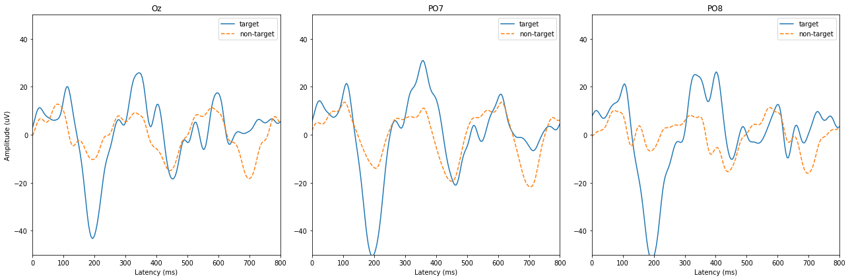
Dataset [Aricò et al., 2014]
10 healthy subjects, 3 runs per session, 6 trials (i.e. character) per run, 8 simulations per trial, 12 classes (10 targets + 2 non targets)
16 channels (Fz, FCz, Cz, CPz, Pz, Oz, F3, F4, C3, C4, CP3, CP4, P3, P4, PO7, PO8), 10-10 montage
Sampling Frequency: 256 Hz, 3.90625 ms/timepoint; Bandpass: 0.1-20Hz
Character prompt (2s)→ stimulation sequences (125ms intensification, 125 ISI, attentional blink avoided in pseudo-randomization)

Slide 4
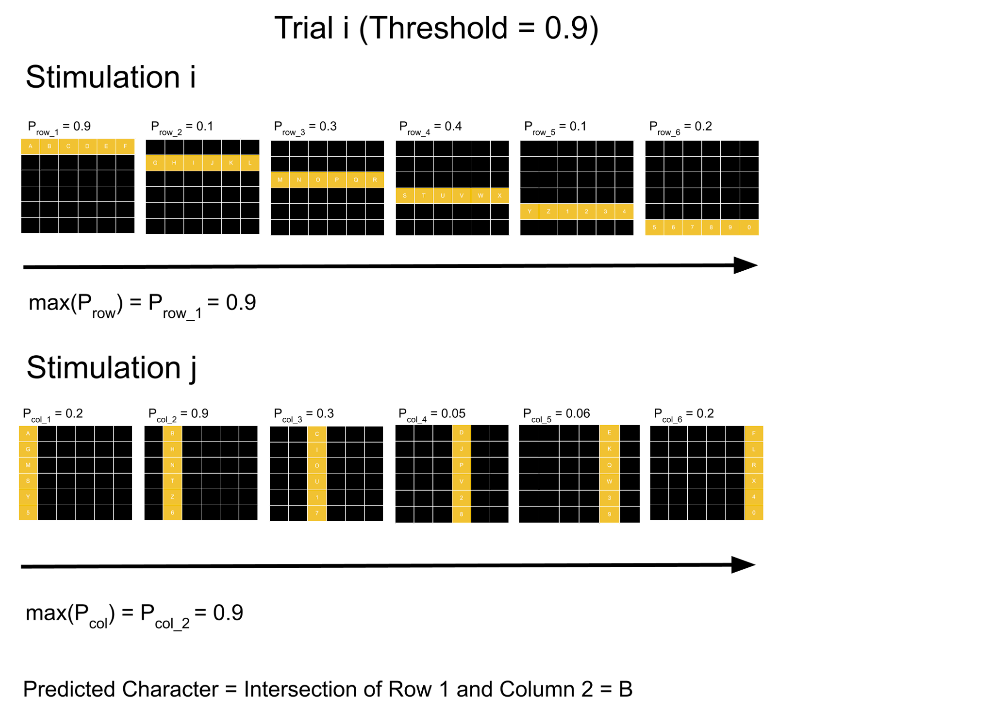
Non-Uniform Dynamic Stopping Algorithm
Probabilities of row or column containing the target character is outputted by the model for each trial and for each stimulation
If the maximum of the row/column probabilities passes the threshold, the row/column with the highest probability is selected
The target character is the intersection of the selected row/column
A threshold of 0.9 was used in this study to aim for a true accuracy of 90%

Slide 5
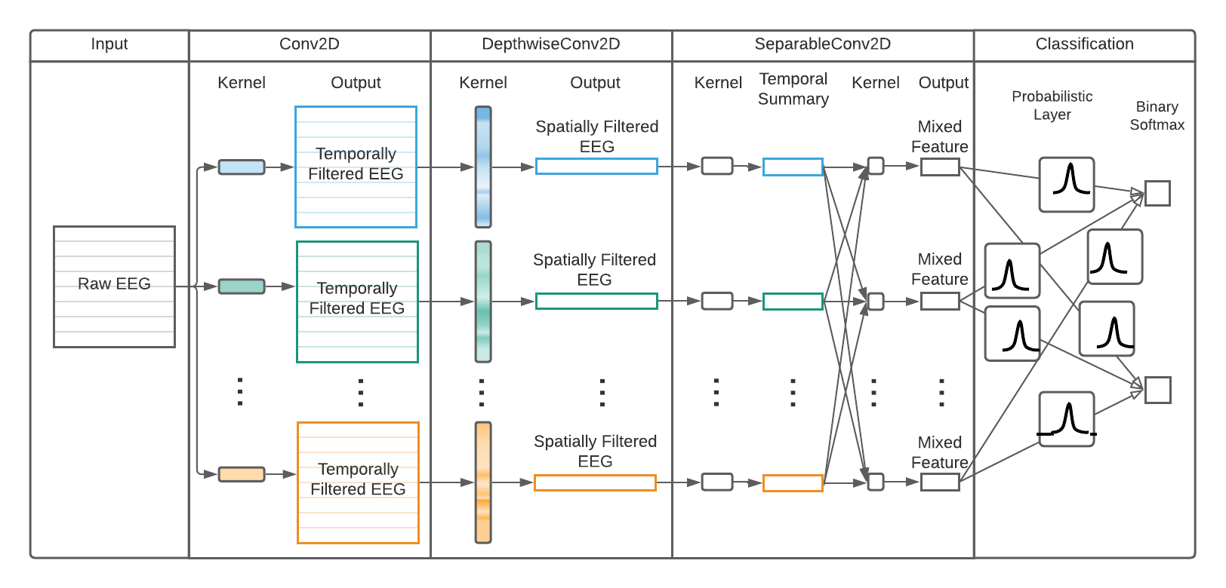
Hybrid Bayesian Neural Network (HBNN)
We use deterministic layers from EEGNet, an EEG classification Convolutional Neural Network (CNN) [Lawhern, 2016]
EEGNet achieves better cross and within-subject performance with fewer parameters than other CNNs
EEGNet contains multiple layers designed as temporal and spatial filters
We use only the output layer as a probabilistic layer to make the BNN less costly and redundant

Slide 6
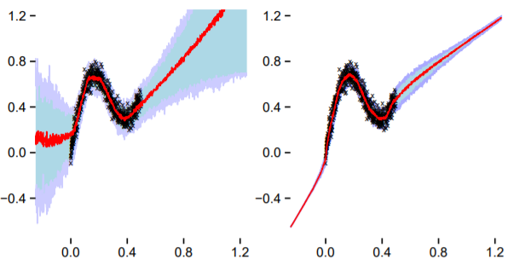

Bayesian Neural Network (BNN)
BNNs use probabilistic layers and Bayesian inference (1) in order to take uncertainty of both data (aleatoric) and predictions (epistemic) into account
By Bayesian inference, we can predict an output y given an unseen data x (2).
(1)
(2)
BNN
NN
[Blundell et al., 2015]

Slide 7


Optimization Problem
The evidence integral (1) in the posterior is intractable, thus it must be estimated through Variational Inference (i.e. Bayes by Backprop [Blundell et al., 2015])
The cost function defined in equation (2) is known as the variational free energy
Minimize KL Divergence while maximizing likelihood in order to find good estimate of posterior
As a standard procedure for Bayesian Neural Network [Jospin, 2020], we use an isotropic Gaussian prior (unit Gaussian in our case) (3)
(1)
(2)
(3)

Slide 8
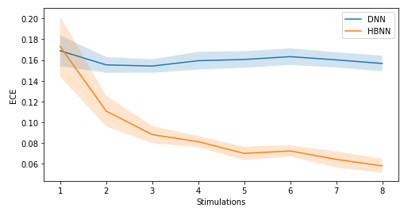
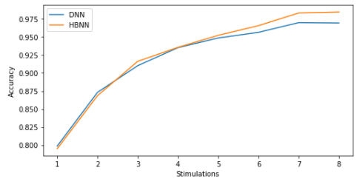
Results: HBNN vs DNN
Hybrid Bayesian Neural Network (HBNN) outperforms Deep Neural Network (DNN) in most stimulations in both ECE and accuracy
ECE: how well the model is calibrated in classifying the presence of P300 evoked potentials across all subjects at different stimulations
accuracy: accuracy in classifying the presence of P300 evoked potentials across all subjects at different stimulation

Slide 9
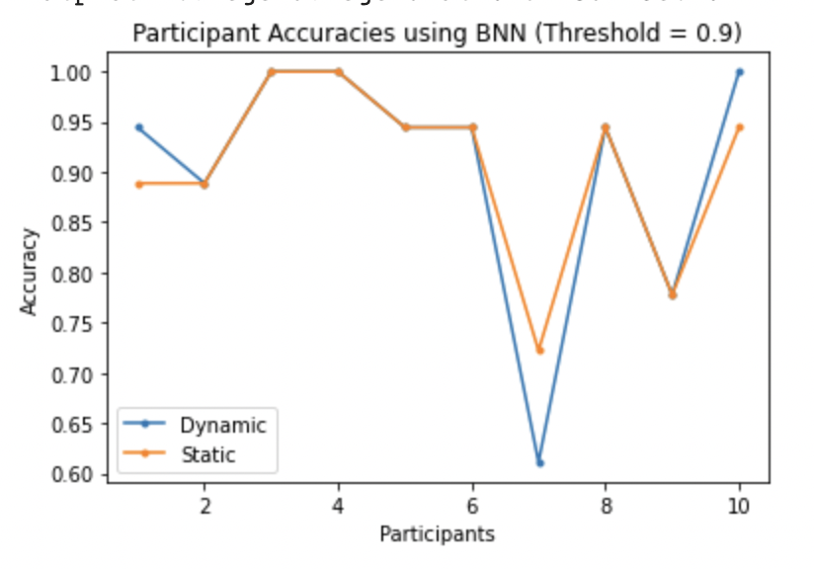
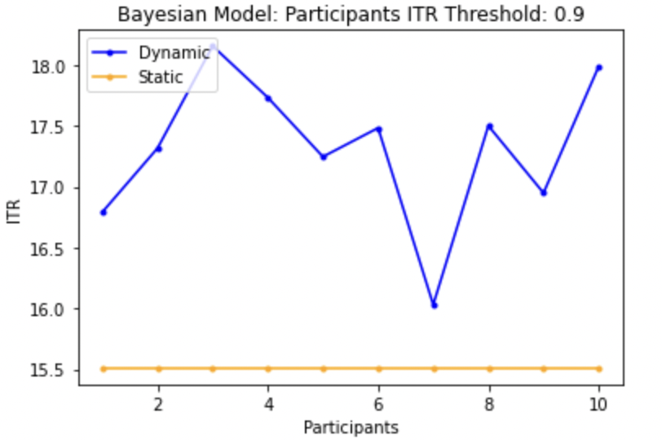
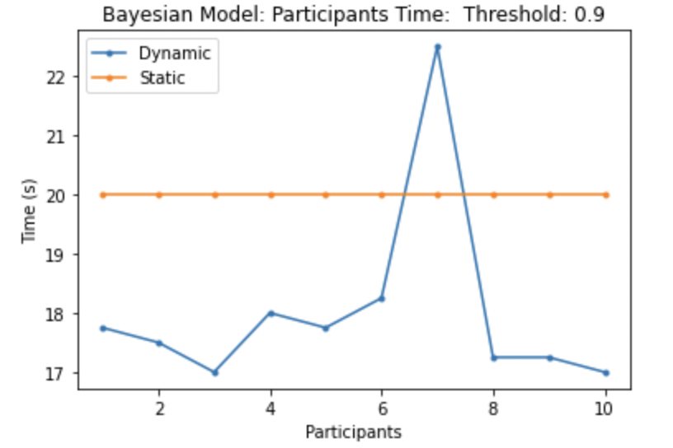
Results: Dynamic vs Static Stopping
Dynamic outperforms static method in both ITR and time without sacrificing accuracy
For ITR, dynamic had a mean ITR of 17.736 bits per minute and static had a mean ITR of 15.509 bits per minute
For time, dynamic took on average 18.205 seconds while static took a constant 20 seconds to predict a character

Slide 10
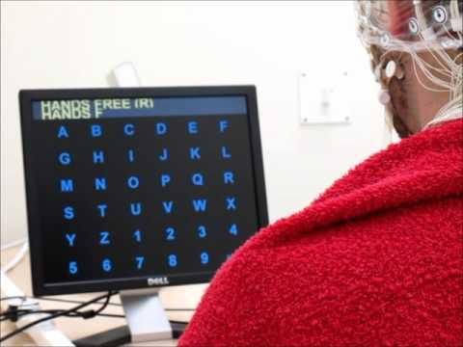
Discussion
Bayesian Neural Network integrated with non-uniform dynamic stopping algorithm provides faster prediction times without sacrificing accuracy
Improvements in ITR is higher by 15.5% compared to recent papers (Li et. al, 2020) regarding dynamic stopping
Overall, higher ITR makes speller more practical and easier to use for patients

